Slide 1
Event Sourcing
Developer Springboard
Workshop

Slide 2
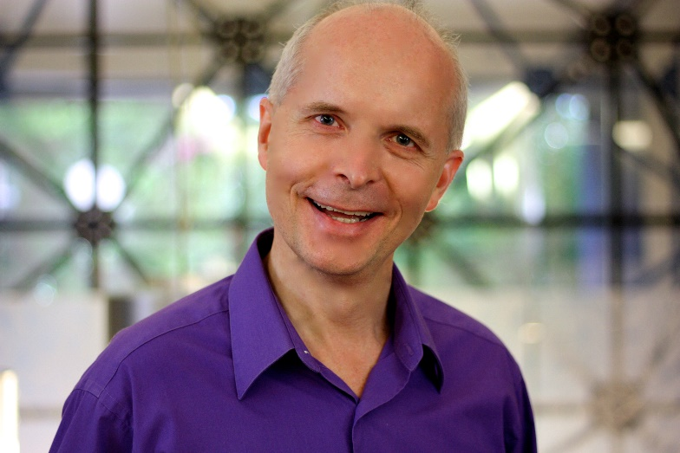




Gabriel N. Schenker
Distinguished Software Architect
PhD in Astrophysics
www.lostechies.com/gabrielschenker
@gnschenker
www.linkedin.com/in/gabrielschenker
https://github.com/gnschenker

Slide 3

Stateful applications
Current state is stored in DB
Previous state is overwritten on each change
Intent or context of change is unclear
History gets lost
Not open for the unknown…

Slide 4


Slide 5
Magic triangle
Client
ACK/NACK
DTOs
Command
Queries
Domain
Read Model
Events
Events
3
Event Store
Replay
2
1

Slide 6
Event store
time
Append only
No change, no delete
Full history
Truth
Replay
Open for the unknown
Event n+1
Event n
Event 3
Event 2
Event 1

Slide 7

Events
Name gives context
Payload tells what has changed → delta
Name is in past tense
Cannot be undone

Slide 8
Events of a single aggregate instance
n - TaskCompleted
Stream
⁞
3 - TaskAccepted
2 - TaskPublished
1 - NewTaskScheduled
Event Store

Slide 9

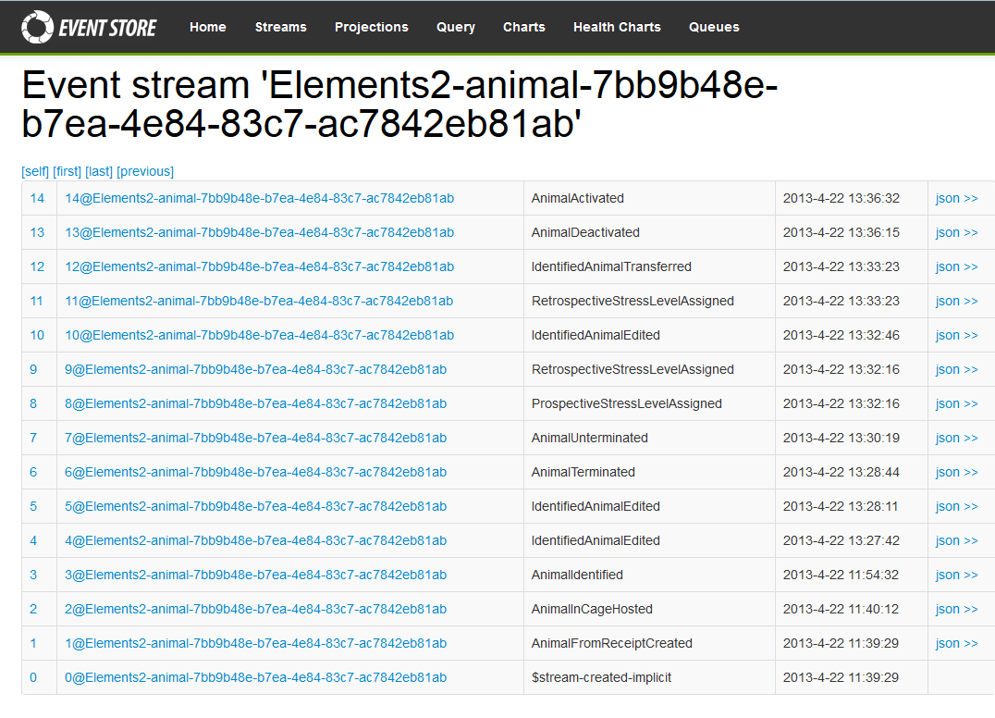
Streams

Slide 10
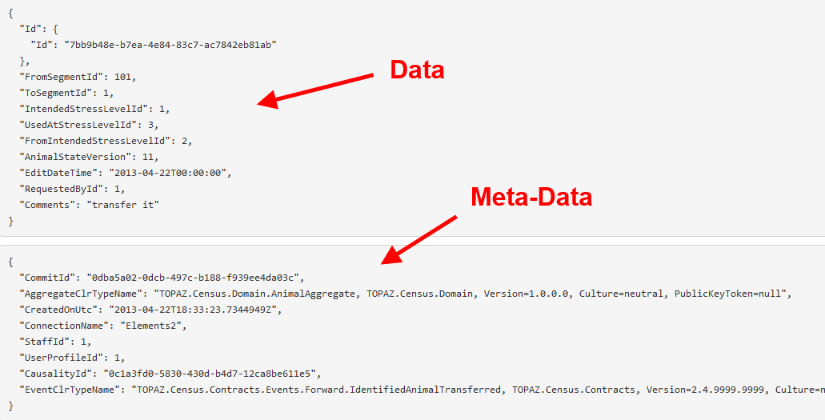
Events
JSON

Slide 11
Task
As part of the so called Heart Beat application which helps to measure the health of projects we want to be able to add new projects. To a project we want to assign a PM, CEM, a team lead and team members, and so on…
Create a RESTful API with some endpoints to accept commands
Convert the commands into appropriate events
Store the events in an Event Store
Create a tool that reads the events from the event store and generates a read model with them

